Slide 1
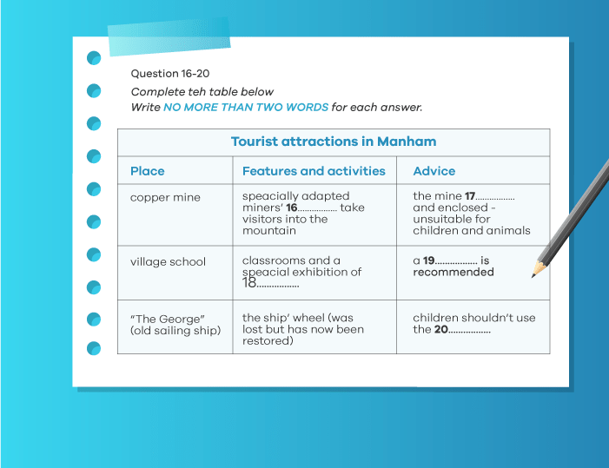
Table
Completion

Slide 2
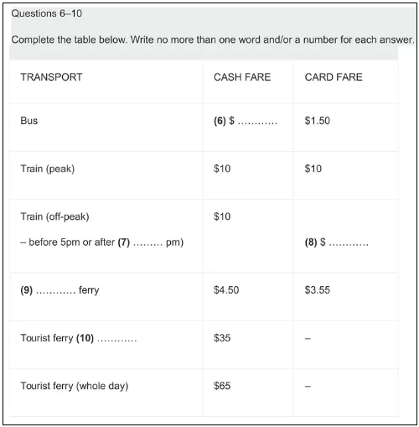

Slide 3
Read the Instructions
Read the instruction carefully, paying particular attention to how many words you are allowed to write for the answer.
The instructions for our sample question state that you must,
Write NO MORE THAN THREE WORDS AND/OR A NUMBER for each answer.
If you write more than three words, your answer will be marked incorrect even if the information you give is correct.

Slide 4
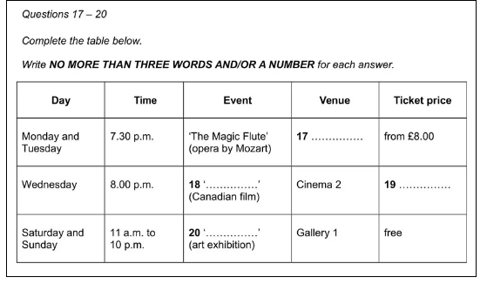
Look at Column Headings
The columns in the table will have headings that tell you what type of information each column contains. It is essential to read these during your preparation time as they will help you to understand the table and give you a big clue as to what sort of information will be contained in the recording.
The column headings in our IELTS Listening sample question are:
Day Time Event Venue Ticket price

